Slide 1
Final Major Project
Dalton Kirk

Slide 2
My Project
Mobile Games made in Unity
Prototypes
One polished game

Slide 3
Casual Game, familiar yet different
Easy for anyone to understand
Clear goals
USP
Well known theme

Slide 4
The Concept
Restaurant
Matches make meals
Serve the customers whilst matching (spinning plates)
Manage stock
Buy better restaurants

Slide 5
Current State of the Game – Management Scene

Slide 6
Current State of the Game – Matching Scene

Slide 7
Current State of the Game – Reputation System
Customers leave ratings when served
Average rating effects reputation when you close
Reputation effects number of customers

Slide 8
Issues Faced
How matches are detected
Spent a lot of time changing the system

Slide 9
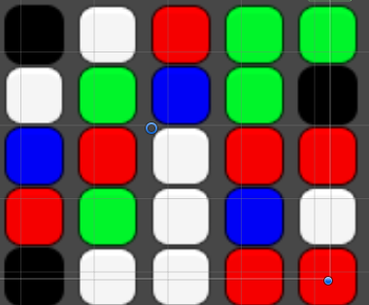
1st Match Detection - List
List = B,W,R,G,G
How to get tiles to fall correctly
Matches over multiple rows

Slide 10
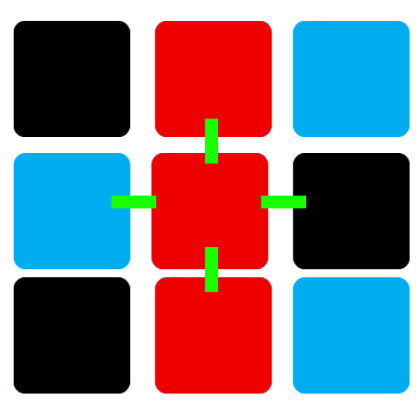
2nd Match Detection - Colliders
Physics + Gravity
Feelers
Can't get more than 3
Not reliable

Slide 11
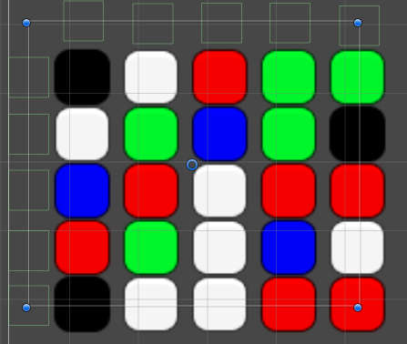
Current Match Detection – My Own Raycasts
Raycasts not reliable
Colliders that pass over tiles
Add tiles to list for the row/column
Check through list for matches

Slide 12
What’s Next?
Finish reputation system
Add second restaurant
Get play testers
Add or change features
Polish

Slide 13
Questions?

